Slide 1
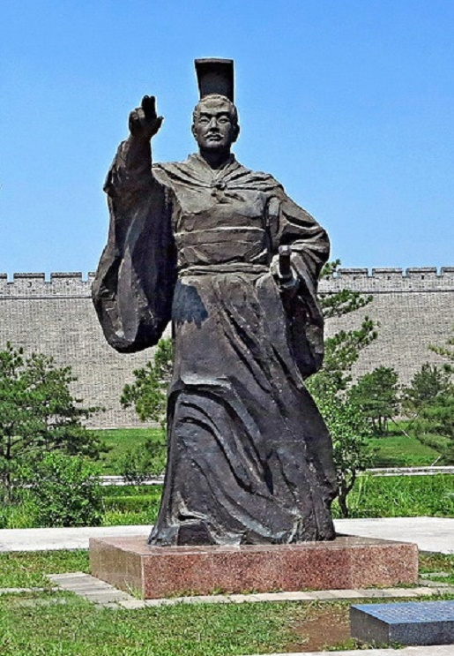
主題：胡人內徙與北魏孝文帝漢化
總論
魏晉南北朝（220-589年）是中國歷史上民族交往最頻繁，亦是民族融合的主要時期。
這個時期，中國北方的鮮卑人，進入中原地區，建立北魏王朝。孝文帝（在位471-499年）為了讓鮮卑人與漢人可以和平共處，不單把首都從平城遷至洛陽，更要求鮮卑族人進行了一系列的漢化運動。
在本課題，你將可以學到：
胡人內徙的經過
孝文帝遷都及他所推行的漢化措施內容（文化及風俗）
漢化措施的影響（如民族融和）
教學節數建議：4
孝文帝像（百度百科）

Slide 2
Topic: Sinicization Measures by Emperor Xiaowen in the Northern Wei Dynasty
Introduction
The Wei, Jin, Southern and Northern Dynasties (220-589) was the period with the most frequent contacts between ethnic groups in Chinese history. As such, it was the main period of ethnic integration.
During this period, the Xianbei ethnic group migrated to northern China and established the Northern Wei Dynasty. To ensure the Xianbei and Han people would live together peacefully, Emperor Xiaowen (reigned 471-499) not only moved the capital from Pingcheng to Luoyang, but also carried out a series of Sinicization campaigns.
In this topic, you will learn about:
1. Southern migration of nomadic tribes
2. Movement of imperial capital and implementation of Sinicization measures by Emperor Xiaowen
3. The impact of the Sinicization measures (such as ethnic integration)
Recommended number of lessons: 4
Emperor Xiaowen statute (Baidu Encyclopedia)

Slide 3
學習重點
胡人內徙的經過
認識孝文帝遷都及他所推行的漢化措施內容
漢化措施的影響（如民族融和）

Slide 4
Learning Objectives
Southern migration of nomadic tribes
Movement of imperial capital and implementation of Sinicization measures by Emperor Xiaowen
The impact of the Sinicization measures (such as ethnic integration)

Slide 5
本節關鍵詞 (Key Terms of the Chapter)
 | 英文詞彙 | 中文詞彙/粵語拼音 | 中文詞彙/普通話拼音
1 | nomadic tribes | 胡人(wu4 jan4) | 胡人(hú rén)
2 | Southern migration | 內徙(noi6 saai2) | 內徙(nèi xǐ)
3 | Northern Wei Dynasty | 北魏(bak1 ngai6) | 北魏(Běi Wèi)
4 | Emperor Xiaowen | 孝文帝(haau3 man4 dai3) | 孝文帝(Xiào Wén Dì)
5 | Xianbei ethnic group | 鮮卑人(sin1 bei1 jan4) | 鮮卑人(Xiān Bēi rén)
6 | Sinicization | 漢化(hon3 faa3) | 漢化(hàn huà)
7 | Farming Livestock | 畜牧(cuk1 muk6) | 畜牧(xù mù)
8 | Farming Crops | 耕種(gaang1 zung3) | 耕種(gēng zhòng)
9 | Han Surname | 漢姓(hon3 sing3) | 漢姓(hàn xìng)
10 | intermarriage between Han and Hu | 漢胡通婚(hon3 wu4 tung1 fan1) | 漢胡通婚(hàn hú tōng hūn)
11 | Burials | 歸葬(gwai1 zong3) | 歸葬(guī zàng)
12 | Hu Clothing | 胡服(wu4 fuk6) | 胡服(hú fú)
13 | Han Clothing | 漢服(hon3 fuk6) | 漢服(hàn fú)

Slide 6
本節概要
魏晉南北朝（220-589年）是中國歷史上民族交往最頻繁，亦是民族融合的主要時期。
這個時期，中國北方的鮮卑人，進入中原地區，建立北魏王朝。
孝文帝（在位471-499年）為了讓鮮卑人與漢人可以和平共處，不單把首都從平城遷至洛陽，更要求鮮卑族人進行了一系列的漢化運動。

Slide 7
Key Points of the Chapter
The Wei, Jin, Southern and Northern Dynasties (220-589) was the period with the most frequent contacts between ethnic groups in Chinese history. As such, it was the main period of ethnic integration.
During this period, the Xianbei ethnic group migrated to northern China and established the Northern Wei Dynasty.
To ensure the Xianbei and Han people would live together peacefully, Emperor Xiaowen (reigned 471-499) not only moved the capital from Pingcheng to Luoyang, but also carried out a series of Sinicization campaigns.

Slide 8
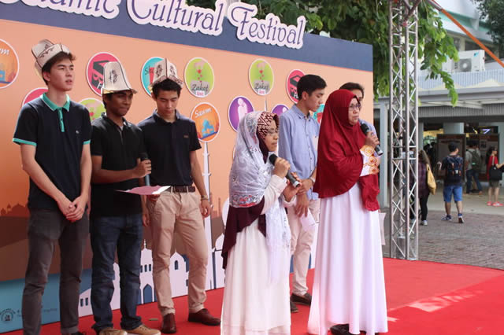
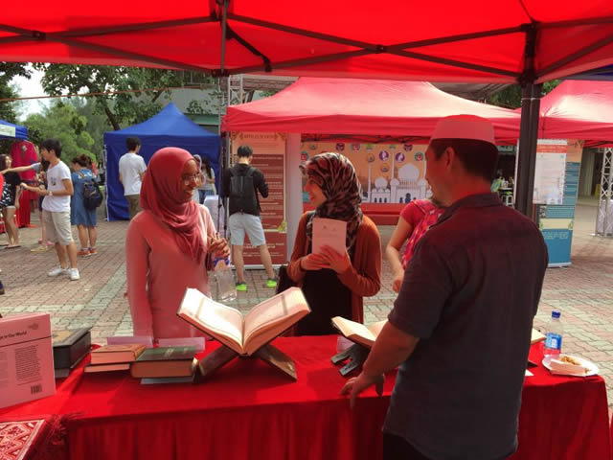
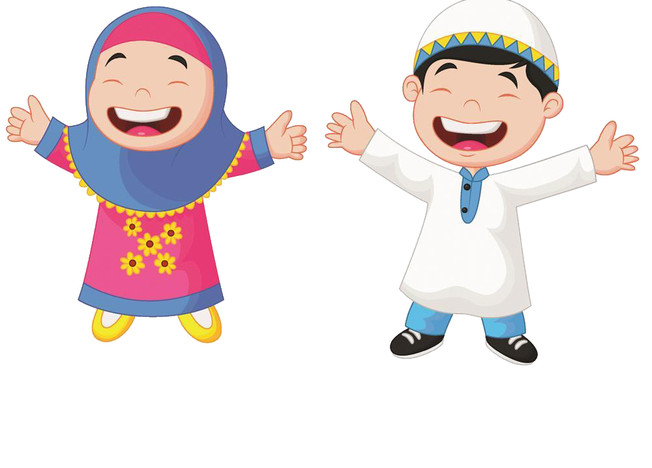
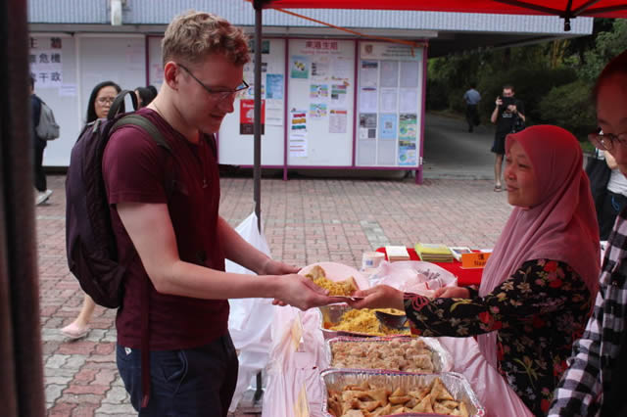
引言：種族共融
2016年，香港中文大學的穆斯林學生，舉辦了一個穆斯林文化節，向其他同學介紹他們的文化。
課堂活動：
請不同族裔同學的代表向班中同學簡介所屬族裔的衣飾、宗教和生活習慣等。

Slide 9
Introduction: Ethnic Harmony
In 2016, Muslim students of the Chinese University of Hong Kong held a Muslim Cultural Festival. There, they introduced their culture to other students.
Classroom activity:
NCS students may introduce to their classmates the clothing, decoration, religion, and living habits of their ethnic groups.

Slide 10
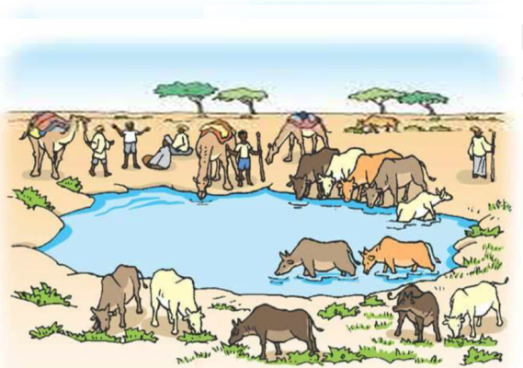
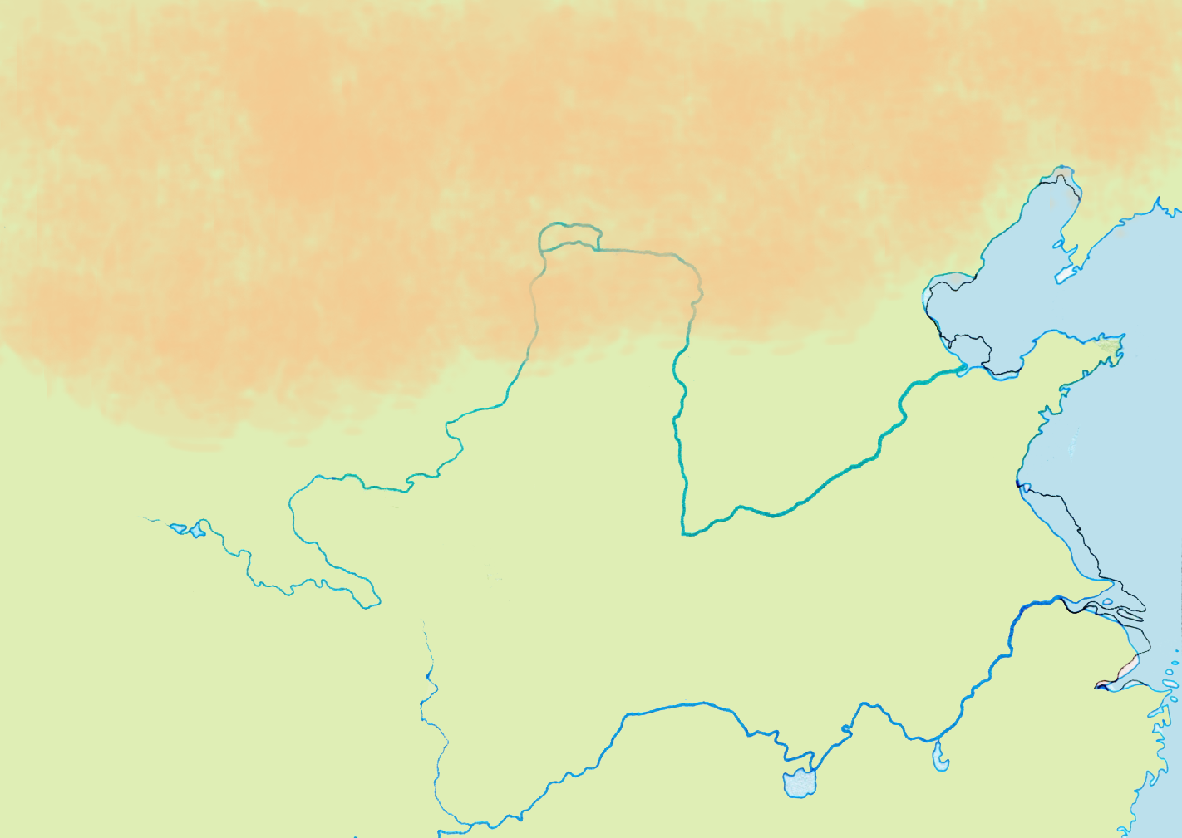
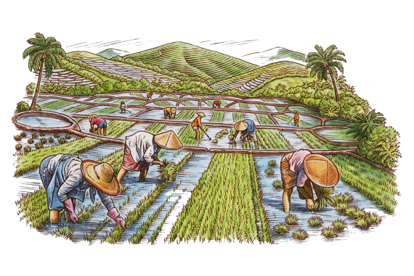
一、北方的環境
活動：北方地方，天氣寒冷，適合什麼的經濟活動？試把圖片和文字置放到下面地圖中啡色和綠色的位置。
黃河
畜牧
耕種
長江

Slide 11
1. The Northern Environment
Activities: In cold climate of the north, what kind of economic activities were suitable? Try to place the pictures and text in the brown and green parts on the map below.
Yellow River
Farming Livestock
Farming Crops
Yangzi River

Slide 12
一、北方的環境
活動：北方地方，天氣寒冷，適合什麼的經濟活動？試把圖片和文字置放到下面地圖中啡色和綠色的位置。
畜牧
黃河
耕種
長江

Slide 13
1. The Northern Environment
Activities: In cold climate of the north, what kind of economic activities were suitable? Try to place the pictures and text in the brown and green parts on the map below.
Farming Livestock
Yellow River
Farming Crops
Yangzi River

Slide 14
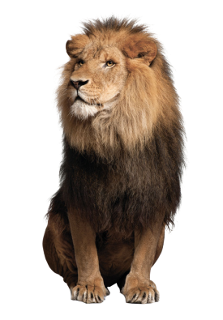
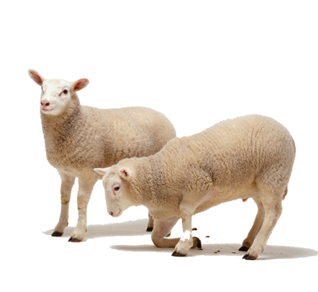
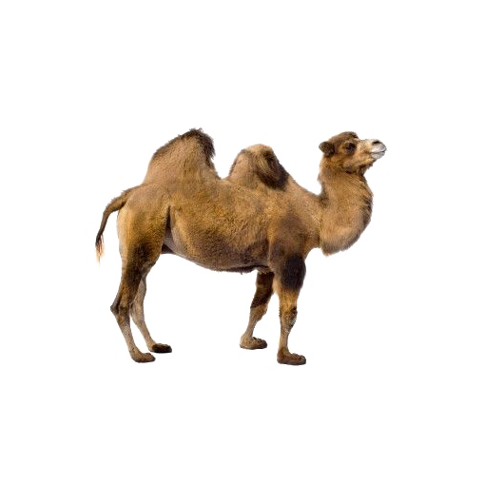
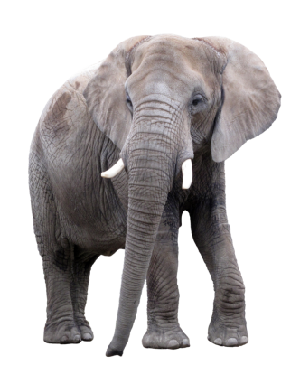
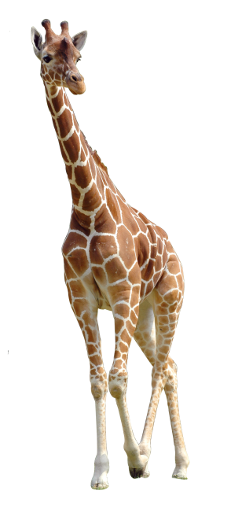
活動：住在北方的人，會把一些當地的動物牧養，作為食物或交通工具，請你把牠們找出來，然後放在地圖上適當的位置。

Slide 15
Activities: People who lived in the north raised local animals for food or transport. Please find them and place them in the appropriate locations on the map.

Slide 16
活動：住在北方的人，會把一些當地的動物牧養，作為食物或交通工具，請你把牠們找出來，然後放在地圖上適當的位置。

Slide 17
Activities: People who lived in the north raised local animals for food or transport. Please find them and place them in the appropriate locations on the map.

Slide 18
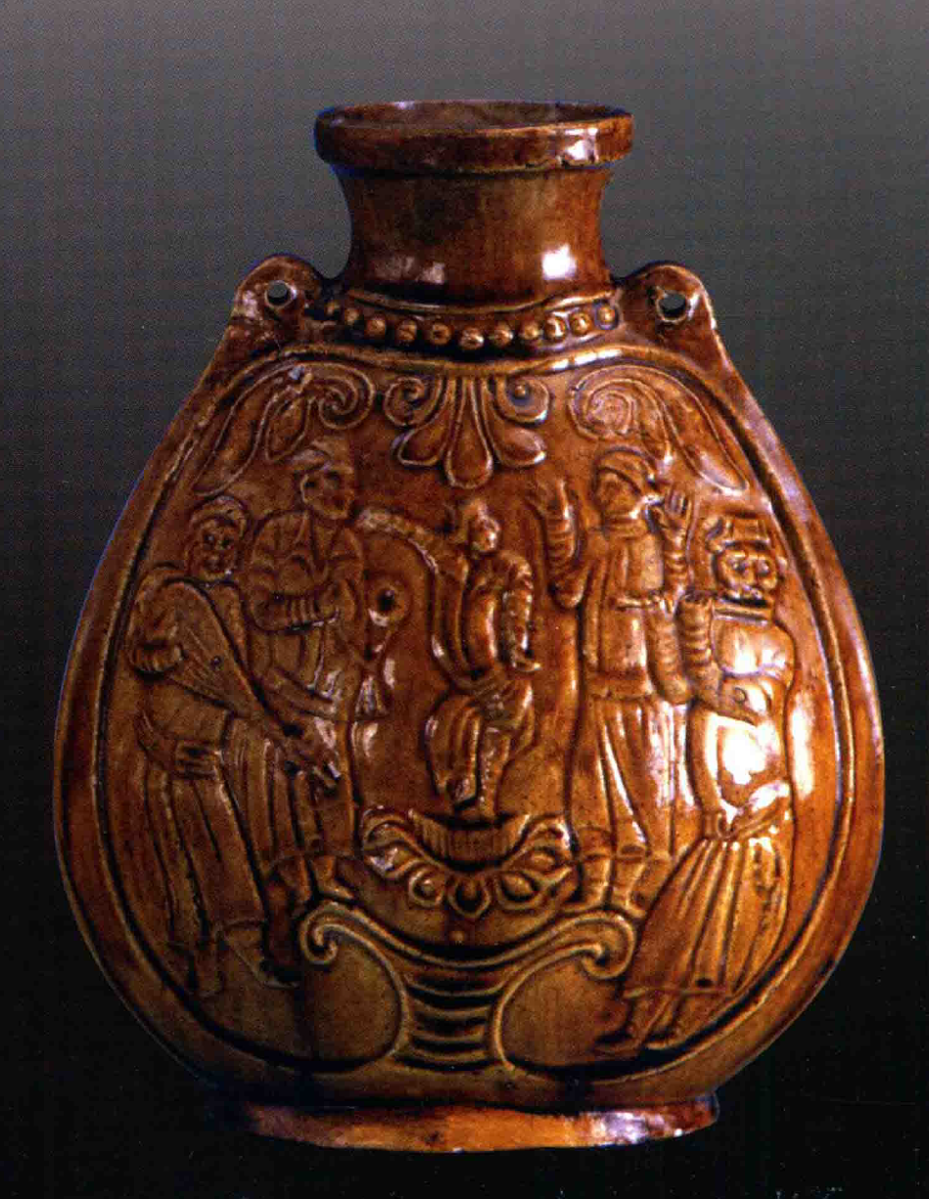
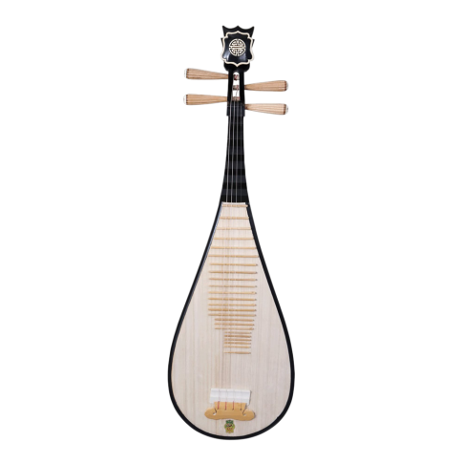
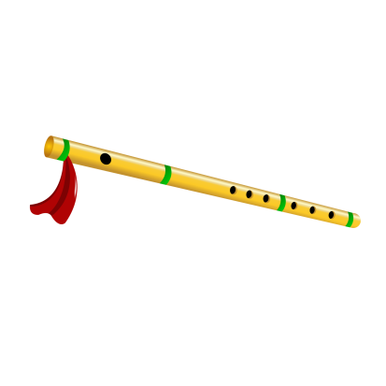
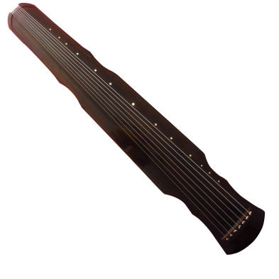
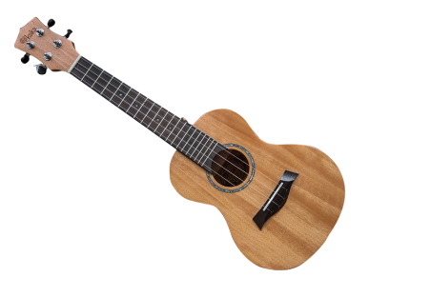
二、胡人的文化
居住在中國北方人們的面貌，與南方人相比，不一定有很大的差別，但文化上很不同。
對於南方的漢人來說，不管這些居住在北方的人，是什麼民族或者部落，一律稱呼他們為胡人。
簡單來說，所謂「胡人」，就是非漢人。
最能表現胡人的文化，便是他們的音樂。
左圖是一個在北齊（550-577年）年代燒製的陶壺，生動地刻畫了五個胡人一邊彈奏樂器，一邊唱歌跳舞的情景。
活動：請把圖中顯示的胡人樂器圈起來
笛子
結他
古琴
琵琶
黃釉陶樂舞紋扁壺（北齊，河南博物院藏）

Slide 19
2. The Culture Of the Northern Nomadic Tribes
The appearance of people living in northern China might not have been very different from that of people living in southern China. But, they were different in their respective cultures
For the Han people in the south, no matter what ethnicity or tribe people living in the north belonged to, these northern people were all called Hu people.
Simply put, who they called "Hu People" were simply non-Han people.
Music was the best expression of the culture of the Hu people.
The ceramic pot on the left was made in the Northern Qi Dynasty (550-577). It vividly shows five Hu people playing musical instruments while singing and dancing.
Activity: Please circle the images of the musical instruments that belonged to the Hu people.
Bamboo Flute
Guitar
Guqin
Ceramic pot made in the 6th century（Northern Qi Dynasty, in Henan Museum)
Pipa

Slide 20
二、胡人的文化
居住在中國北方人們的面貌，與南方人相比，不一定有很大的差別，但文化上很不同。
對於南方的漢人來說，不管這些居住在北方的人，是什麼民族或者部落，一律稱呼他們為胡人。
簡單來說，所謂「胡人」，就是非漢人。
最能表現胡人的文化，便是他們的音樂。
左圖是一個在北齊（550-577年）年代燒製的陶壺，生動地刻畫了五個胡人一邊彈奏樂器，一邊唱歌跳舞。
活動：請把圖中顯示的胡人樂器圈起來
笛子
結他
古琴
琵琶
黃釉陶樂舞紋扁壺（北齊，河南博物院藏）

Slide 21
2. The Culture Of the Northern Nomadic Tribes
The appearance of people living in northern China might not have been very different from that of people living in southern China. But, they were different in their respective cultures
For the Han people in the south, no matter what ethnicity or tribe people living in the north belonged to, these northern people were all called Hu people.
Simply put, who they called "Hu People" were simply non-Han people.
Music was the best expression of the culture of the Hu people.
The ceramic pot on the left was made in the Northern Qi Dynasty (550-577). It vividly shows five Hu people playing musical instruments while singing and dancing.
Activity: Please circle the images of the musical instruments that belonged to the Hu people.
Bamboo Flute
Guitar
Guqin
Ceramic pot made in the 6th century（Northern Qi Dynasty, in Henan Museum)
Pipa

Slide 22
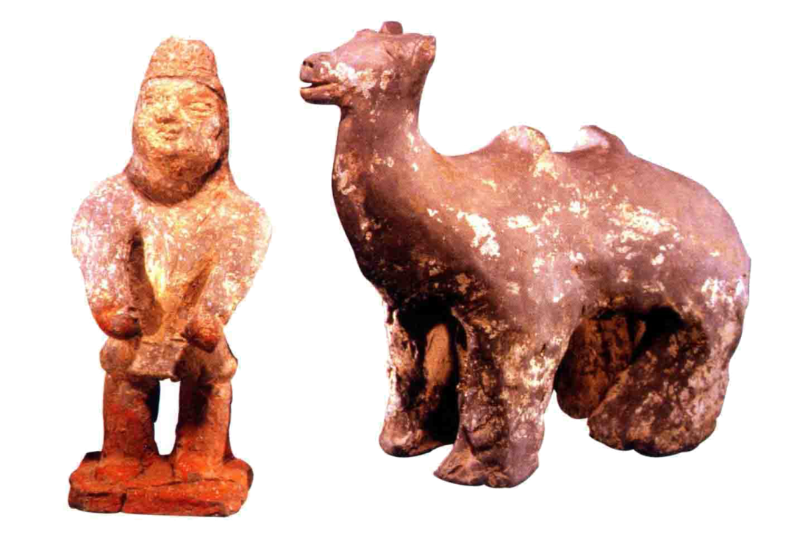
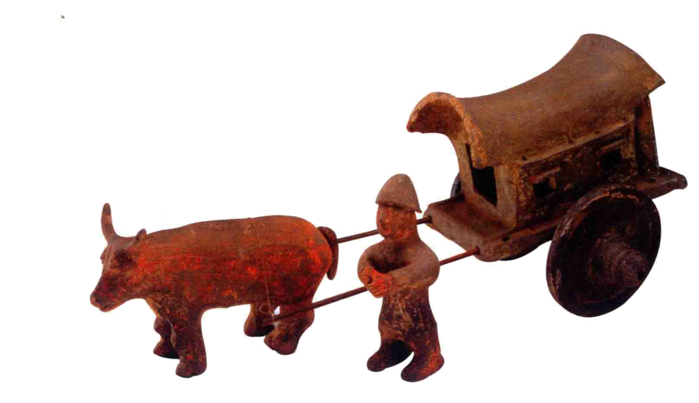
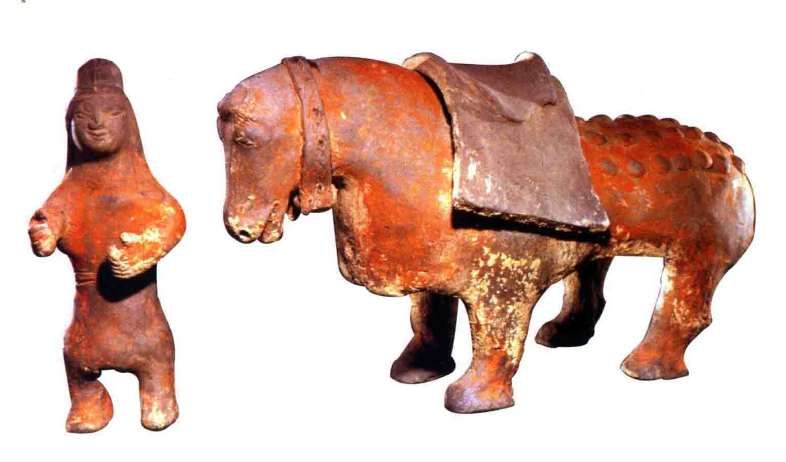
活動：圖中都是胡人的交通工具，請用英文字母將它們分別標示。
牛車（短距離交通工具，南方漢人也常使用）
馬（長距離交通工具，快速，但須懂得騎馬）
駱駝（是沙漠或絲綢之路的最佳交通工具）

Slide 23
Activity: Below means of transportation in the picture were used by the Hu people. Please use the letters to identify them.
A. Ox cart (short distance transportation, also frequently used by the Southern Han people)
B. Horse (long-distance transportation, fast, but the user must learn to ride)
C. Camel (the best means of transportation in the desert or on the Silk Road)

Slide 24
活動：圖中都是胡人的交通工具，請用英文字母將它們分別標示。
牛車（短距離交通工具，南方漢人也常使用）
馬（長距離交通工具，快速，但須懂得騎馬）
駱駝（是沙漠或絲綢之路的最佳交通工具）
C
B
A

Slide 25
Activity: Below means of transportation in the picture were used by the Hu people. Please use the letters to identify them.
A. Ox cart (short distance transportation, also frequently used by the Southern Han people)
B. Horse (long-distance transportation, fast, but the user must learn to ride)
C. Camel (the best means of transportation in the desert or on the Silk Road)
C
B
A

Slide 26
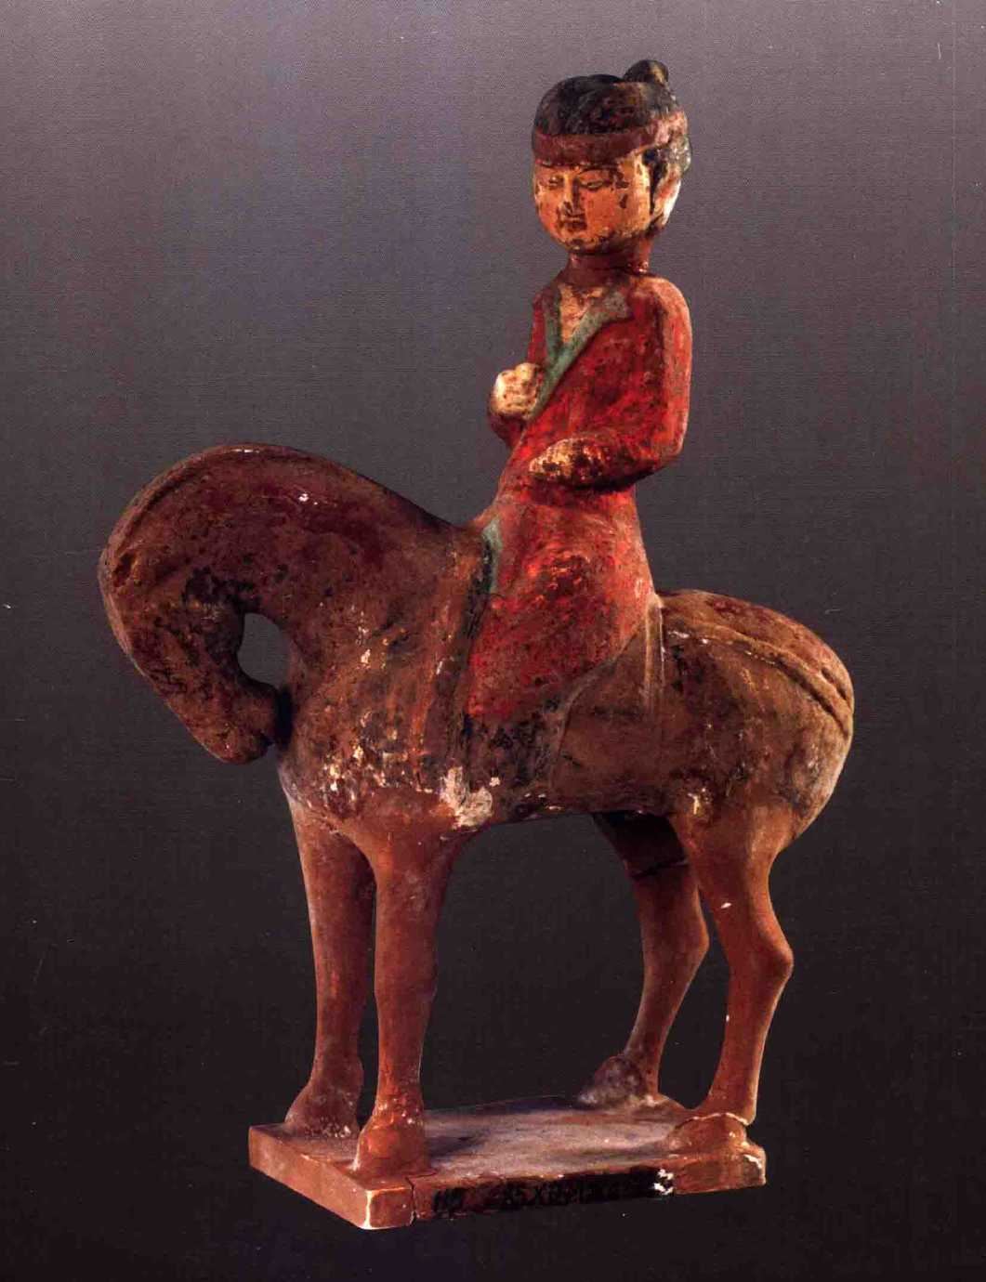
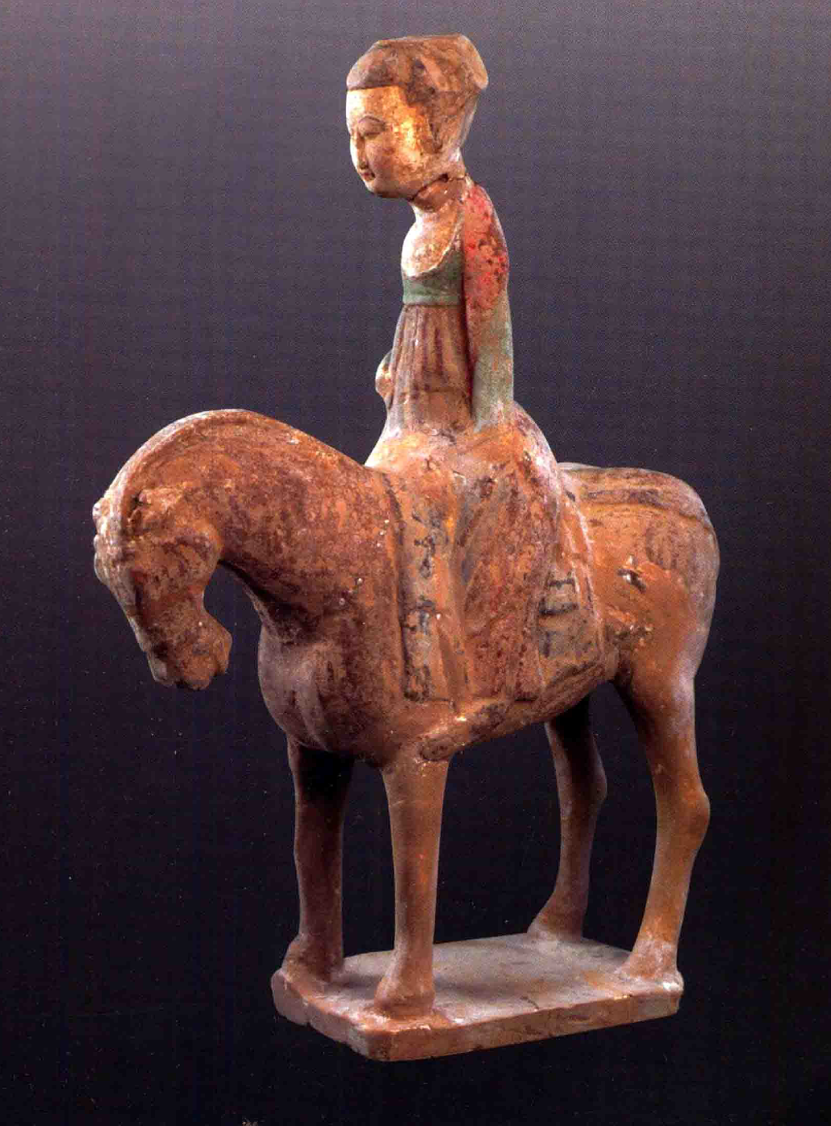
在漢人社會，有教養的婦女不能隨便到處走動；但胡人婦女騎馬出遊，卻是正常不過的事情。
北周彩繪騎馬女俑（陝西考古研究所）
北周彩繪騎馬女俑（陝西考古研究所）

Slide 27
In Han society, well-educated women could not walk around casually. However, it was normal for Hu women to travel by horse.
A horse-riding lady
(Northern Zhou Dynasty, Collection of Shaanxi Academy of Archaeology)
A horse-riding lady
(Northern Zhou Dynasty, Collection of Shaanxi Academy of Archaeology)

Slide 28
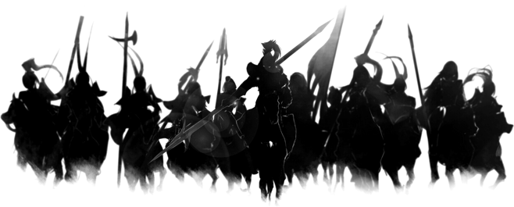
三、胡人內徙
公元4世紀左右，居住在中國北方的遊牧民族，憑著優良的騎兵裝備，向比較溫暖的南方遷徙，並且逐漸在黃河流域一帶定居下來。
他們大概可以分為五大族—匈奴、鮮卑、羯、氐和羌，統稱為「五胡」。
公元386年，其中一「胡」在內徙的聚落範圍內，建立起北魏政權。請你在地圖上填上這個族群的名稱。
鮮卑
羯
羌
匈奴
氐

Slide 29
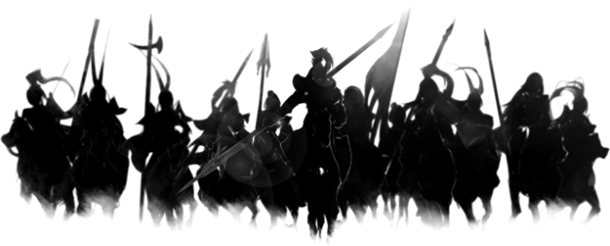
3. The Southern Migration of the Hu people
Around the 4th century AD, the nomadic ethnic groups living in northern China, relying on excellent cavalry equipment, migrated to the warmer south. They gradually settled in the Yellow River valley.
They can be roughly divided into five big ethnic groups-Xiongnu, Xianbei, Jie, Di and Qiang, collectively called "Five Hus."
In 386 AD, an ethnic group established the Northern Wei regime in northern China. Please fill in the name of this ethnic group on the map.
Xianbei
Jie
Qiang
Xiongnu
Di

Slide 30
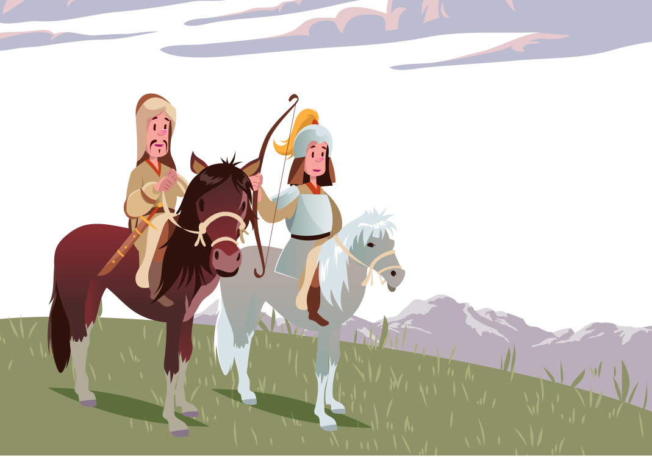
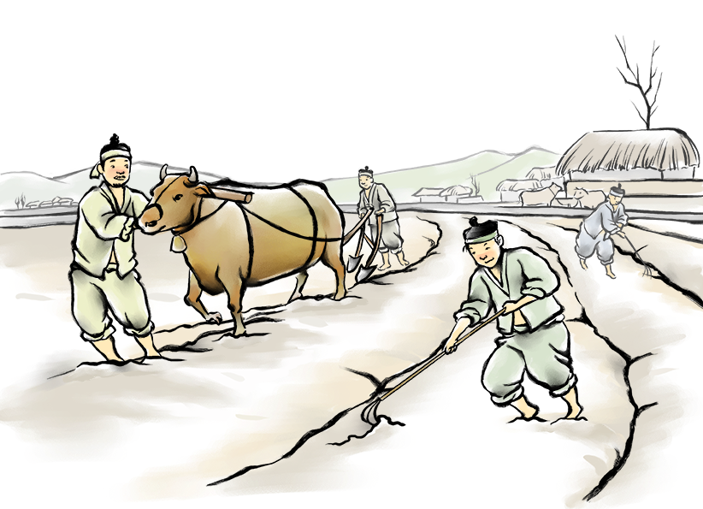
胡人遷徙到黃河流域，如何適應新的生活？
公元380年，一直以打獵為生的鮮卑兩父子來到了黃河邊上，計劃過新生活。找了朋友拍照作為紀錄。
公元390年，兒子已經結婚，太太是當地的漢人，剛剛生了孩子。兩父子在耕田，太太替他們拍了照。
1.7.380
1.7.390
各位同學：試想想這兩父子從380年到390年的生活會有什麼改變？
是非題：
天氣較以前寒冷，只能繼續狩獵為生。（是/非）（請刪一）
天氣暖和了，可以耕種，並在農田附近建立房子居住。（是/非）（請刪一）
兒子與漢人通婚。（是/非）（請刪一）

Slide 31
How did the Hu people adapt to their new lives after migrating to the Yellow River valley?
In 380 AD, a Xianbei hunter, together with his son, came to the bank of the Yellow River and planned to start a new life there. They found a friend to take a picture of the place where they settled as record.
In 390 AD, the son was married. His wife was a local Han person who had just given birth to a child. The father and son were plowing the fields, and his wife took a photo for them.
1.7.380
1.7.390
Question: Imagine how did the lives of the father and son differ from 380 to 390?
True or false:
The weather was colder than before, so they could only continue hunting to survive. (True/False) (please delete one)
The weather was warmer, so they could build houses near the farmland to live in. (True/False) (please delete one)
The son intermarried with the Han Chinese. (True/False) (please delete one)

Slide 32
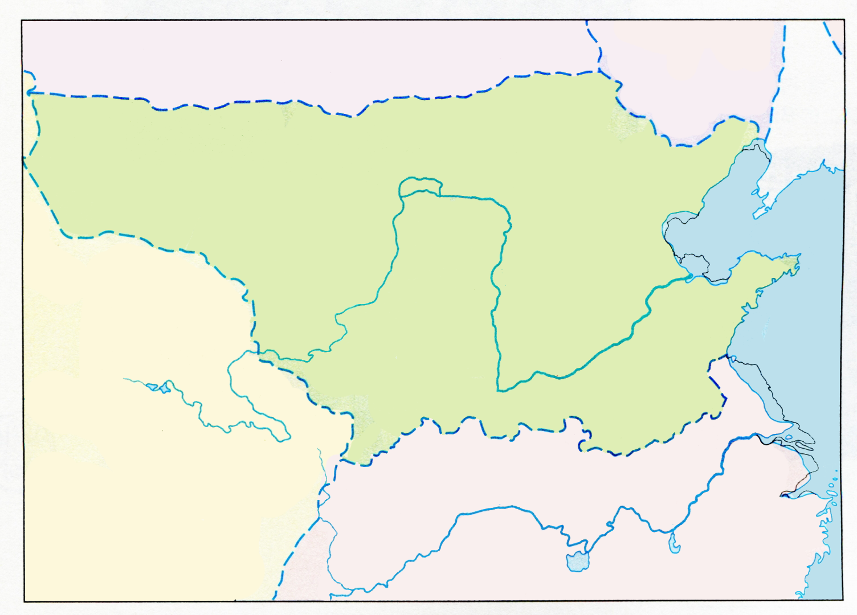
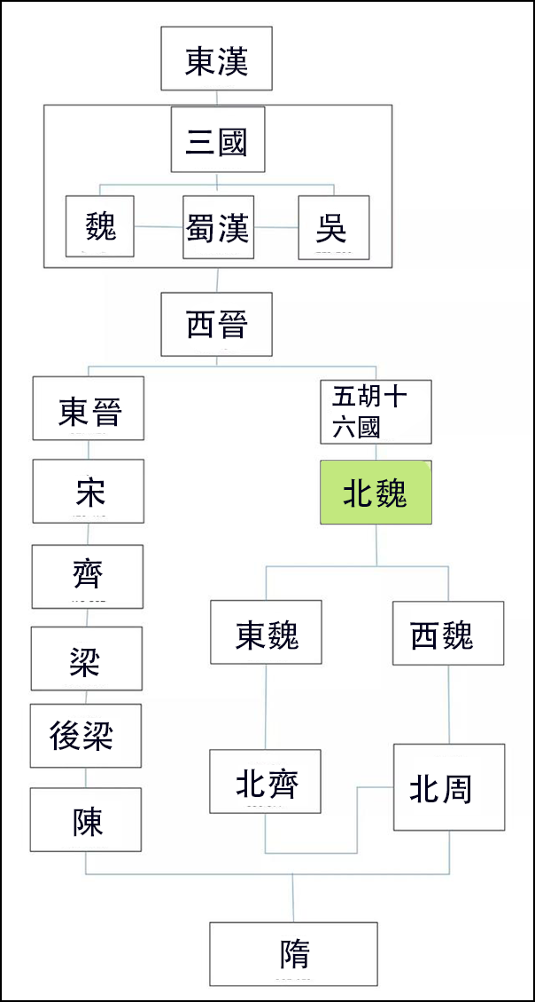
北魏
南朝
北朝
北魏小資料
民族：胡（鮮卑）
朝代年份：________（請填上）
屬中國分裂狀態中的：南朝/北朝？（請刪一）
領土：中國北方/中國南方？（請刪一）
386-534

Slide 33
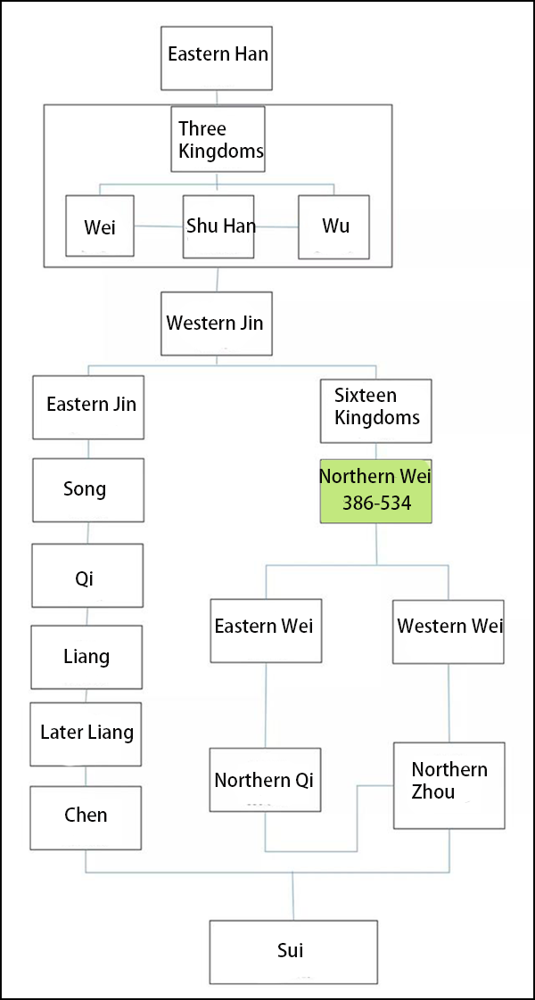
Northern Wei
Southern Dynasties
Northern Dynasties
Facts about Northern Wei
Ethnicity: Hu (Xianbei)
Time period：________ (Please fill in)
Belongs to which half of China: Southern Dynasty/Northern Dynasty？(Please delete one)
Territory: Northern China/ Southern China? (Please delete one)
386-534

Slide 34
四、北魏孝文帝漢化措施
北魏天子
1. 道武帝 386-409
2. 明元帝 409-423
3. 太武帝 423-452
4. 文成帝 452-465
5. 獻文帝 465-471
6. 孝文帝 471-499
7. 宣武帝 499-515
8. 孝明帝 515-528
9. 孝莊帝 528-530
10. 節閔帝 531
11. 廢帝 531-532
12. 孝武帝 532-534
公元493年，北魏孝文帝從平城（今山西大同）遷都洛陽。同學請利用提供的詞語，完成以下平城與洛陽的比較表。
1. 遷都洛陽
 | 平城 | 洛陽
溫度
土地
糧食
交通
寒冷
溫暖
北魏
平城
貧瘠
肥沃
短缺
充足
困難
方便
洛陽
方便
貧瘠
溫暖
短缺
齊
肥沃
充足
困難
寒冷

Slide 35
4. Sinicization Measures of Emperor Xiaowen of the Northern Wei Dynasty
Emperors of the Northern Wei Dynasty
1. Emperor Daowu 386-409
2. Emperor Mingyuan 409-423
3. Emperor Taiwu 423-452
4. Emperor Wencheng 452-465
5. Emperor Xianwen 465-471
6. Emperor Xiaowen 471-499
7. Emperor Xuanwu 499-515
8. Emperor Xiaoming 515-528
9. Emperor Xiaozhuang 528-530
10. Emperor Jiemin 531
11. Emperor Fei 531-532
12. Emperor Xiaowu 532-534
In 493 AD, Emperor Xiaowen of the Northern Wei Dynasty moved the capital to Luoyang from Pingcheng (now Datong, Shanxi). Please use the phrases provided to complete the following comparison table between Pingcheng and Luoyang.
1. Move the capital to Luoyang
 | Pingcheng | Luoyang
Temperature
Land
Food
Transport
Cold
Warm
Northern Wei
Pingcheng
Barren
Fertile
Shortage
Abundant
Inconvenient
Convenient
Luoyang
Convenient
Barren
Warm
Shortage
Qi
Fertile
Abundant
Inconvenient
Cold

Slide 36
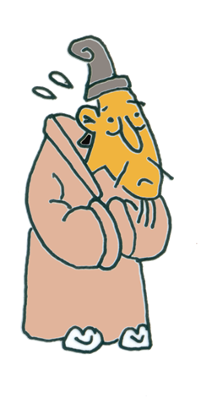
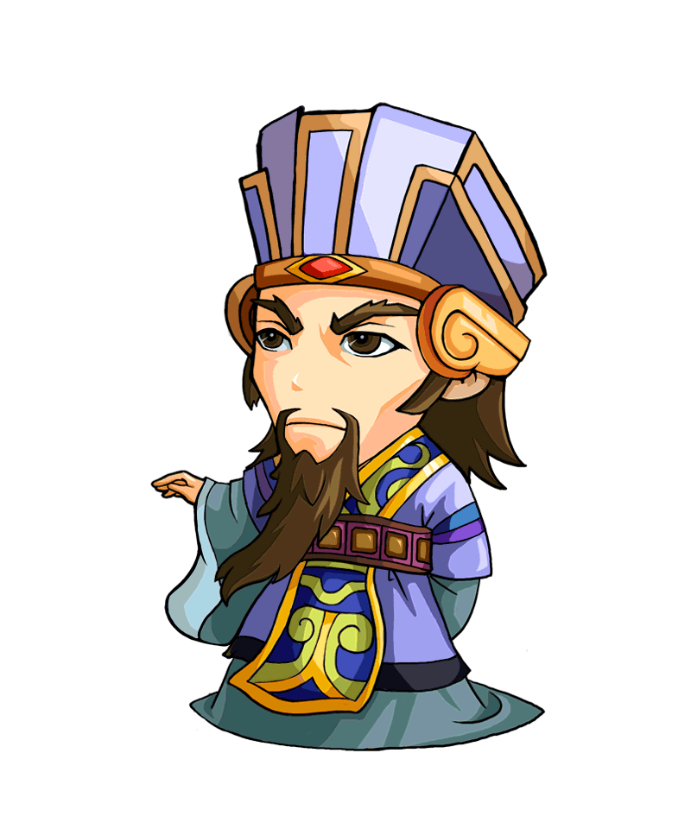
1. 洛陽是東漢和魏晉首都，洛陽人都是很有文化的，都害怕被胡人統治。勉強把胡人和漢人混雜在一起，雙方都不會快樂！(Luoyang was the capital of the Eastern Han Dynasty and the Wei-Jin Dynasties. Luoyang people are very educated and they are afraid of being ruled by the Hu people. By placing the Hu people with the Han people, neither side will be happy!)
2. 不用擔心，我會命令胡人進行漢化。文化分歧減少了，彼此便可以融洽相處。(Do not worry. I will order the Hu people to become more Chinese in their culture. Cultural differences will be reduced, and everyone can live happily together.)
3. 太好了！我們洛陽人也放心，將誠心地向皇上效忠！(Great! We of Luoyang are relieved. We will be loyal to the emperor!)
漢人大臣(Han Minister)
孝文帝(Emperor Xiaowen)

Slide 37
Luoyang was the capital of the Eastern Han Dynasty and the Wei-Jin Dynasties. Luoyang people are very educated and they are afraid of being ruled by the Hu people. By placing the Hu people with the Han people, neither side will be happy!
Do not worry. I will order the Hu people to become more Chinese in their culture. Cultural differences will be reduced, and everyone can live happily together.
Han Minister
Great! We of Luoyang are relieved. We will be loyal to the emperor!
Emperor Xiaowen

Slide 38
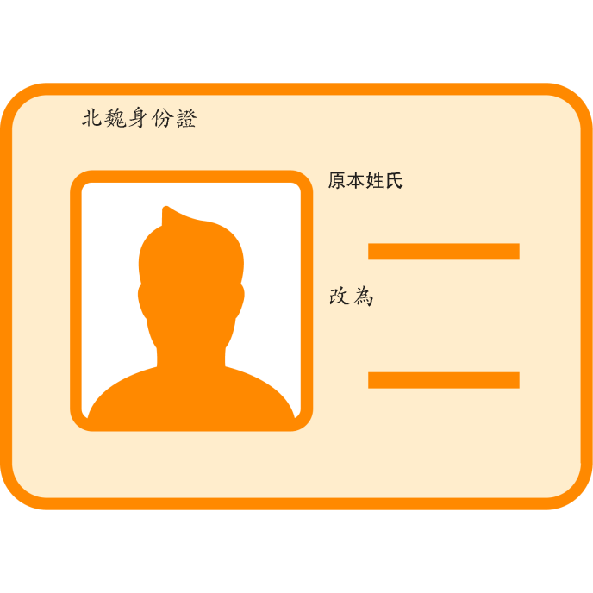
四、北魏孝文帝漢化措施
2. 改胡姓為漢姓
胡人姓氏 | 漢姓
拓跋 | 元
步六孤 | 陸
獨孤 | 劉
丘穆稜 | 穆
賀賴 | 賀
賀樓 | 樓
拓跋
元
請為鮮卑人填上新的漢姓
活動：請表列班中少數族裔同學的中文姓氏
獨孤
步六孤
原本外文姓氏 | 中文姓氏
劉
陸

Slide 39
2. Turning Hu Surnames into Han Surnames
Hu Surname | Han Surname
Tuoba | Yuan
Buliugu | Lu
Dugu | Liu
Qiumuleng | Mu
Helai | He
Helou | Lou
Tuoba
Yuan
Please help to fill in the new Han surname for these Xiangbei people
Activity: Please list the Chinese surnames of the ethnic minority students in the class
Dugu
Buliugu
Surname in your native language | Chinese Surname
Liu
Lu

Slide 40
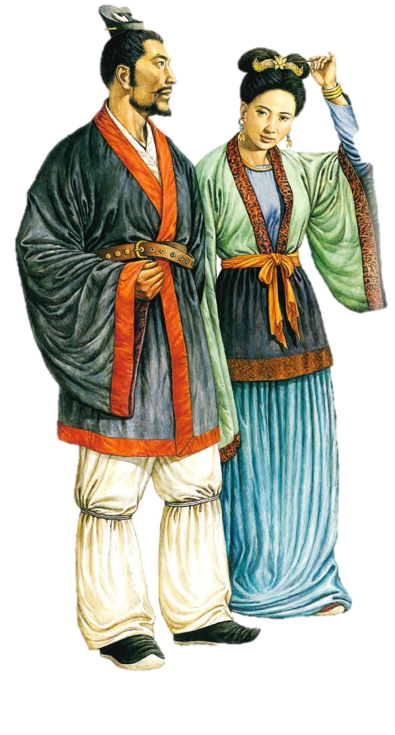
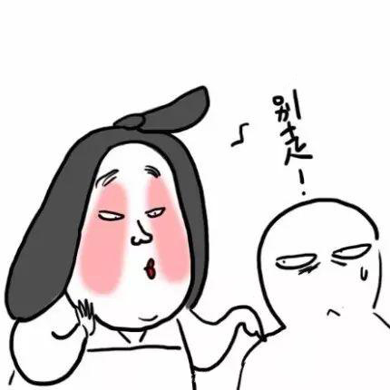
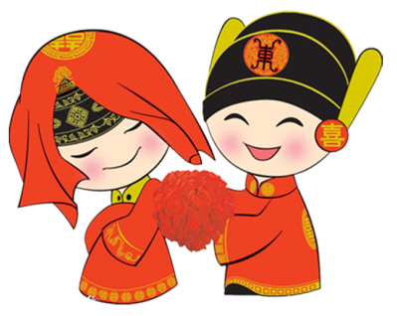
四、北魏孝文帝漢化措施
3. 鼓勵漢胡通婚
孝文帝自己，弟弟和兒子，
都娶了漢人女子為妻，又把公主嫁給漢人。
例如孝文帝次女蘭陵公主，便是嫁給來自南方的貴族劉輝。
漢化了的鮮卑人
（《長城歷史與文物》，
香港歷史博物館，2002年，頁90）

Slide 41
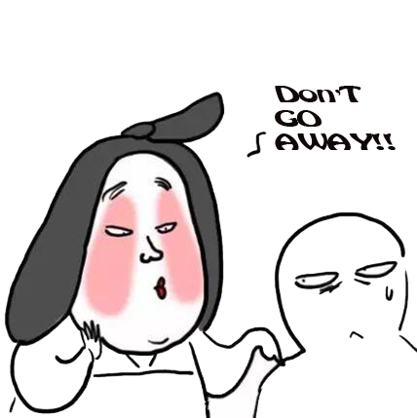
3. Promoting intermarriage between Han and Hu
Emperor Xiaowen himself, his younger brother, and his son all married Han women as their wives and married their princesses to Han men.
For example, Princess Lanling, the second daughter of Emperor Xiaowen, was married to Liu Hui, a southern nobleman.
Sinicized Xianbei people
(picture in 《長城歷史與文物》）

Slide 42
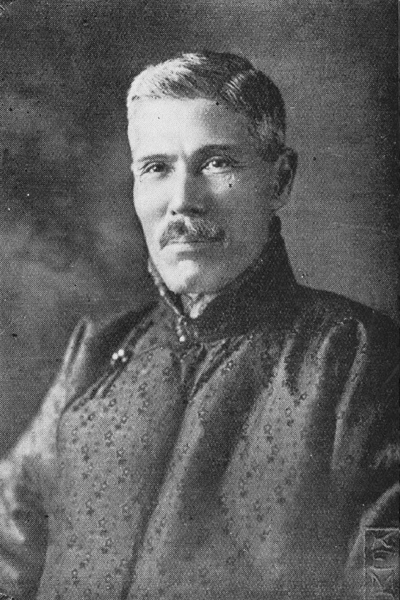
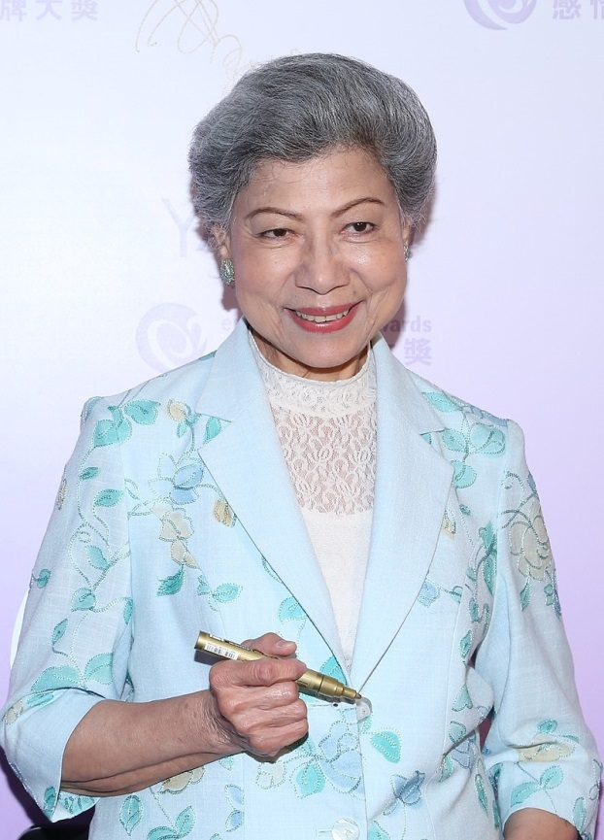
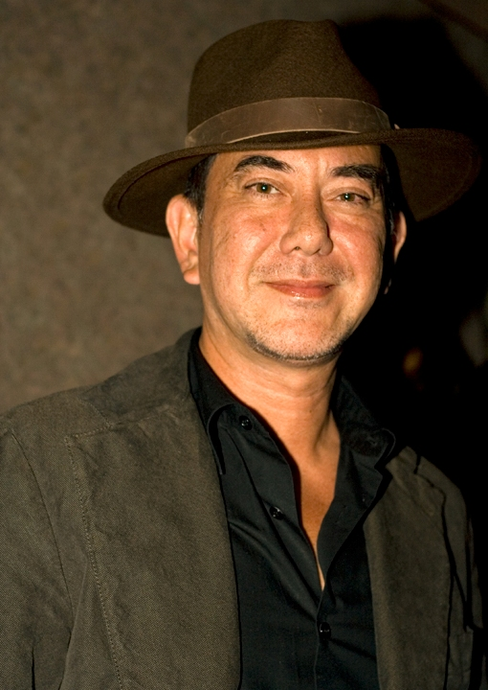
在香港居住的混血兒
請多舉一個你熟悉的例子：
香港小姐 2020
謝嘉怡
中國和蘇格蘭混血兒
企業家何東
（1862-1956）
中國和猶太混血兒
著名女演員羅蘭
(1934-)
中印混血兒
著名男演員黃秋生
（1961-）
中英混血兒

Slide 43
Multiracial people in Hong Kong
Please give one more example
Miss Hong Kong Pageant 2020
Lisa-Marie Tse
Chinese and Scottish
Sir Robert Ho Tung
(1862-1956)
Businessman
Chinese and Jewish
Law Lan
(1934-)
Actress
Chinese and Indian
Anthony Wong Chau-sang (1961-)
Actor
Chinese and English

Slide 44
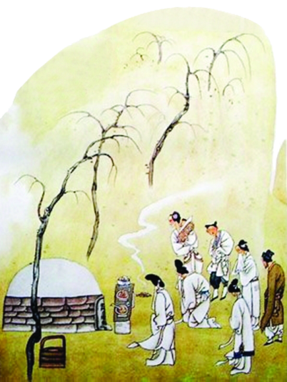
四、北魏孝文帝漢化措施
4. 禁歸葬平城
北魏
住在洛陽，葬在洛陽
Live in Luoyang; die in Luoyang
Northern Wei
平城
Pingcheng
×
洛陽
Luoyang
齊
Qi

Slide 45
4. Banning Burials in Pingcheng
When Xianbei people come to Luoyang, they should work hard to learn to be a Han person. They should not think about returning to Pingcheng in their old age, not even to die!
Northern Wei
Pingcheng
×
Live in Luoyang; die in Luoyang
Luoyang
Qi

Slide 46
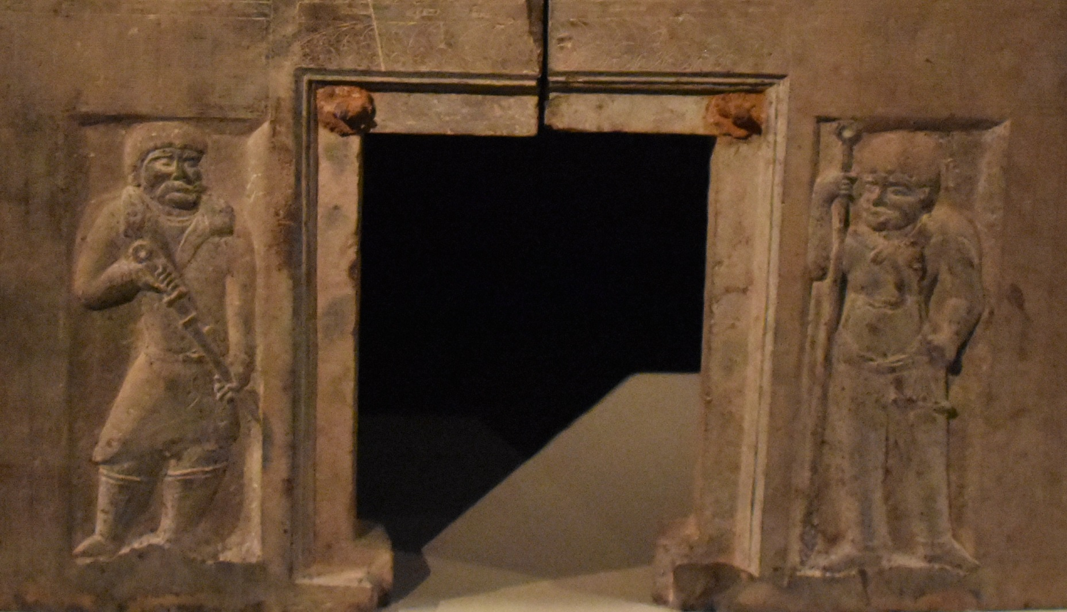
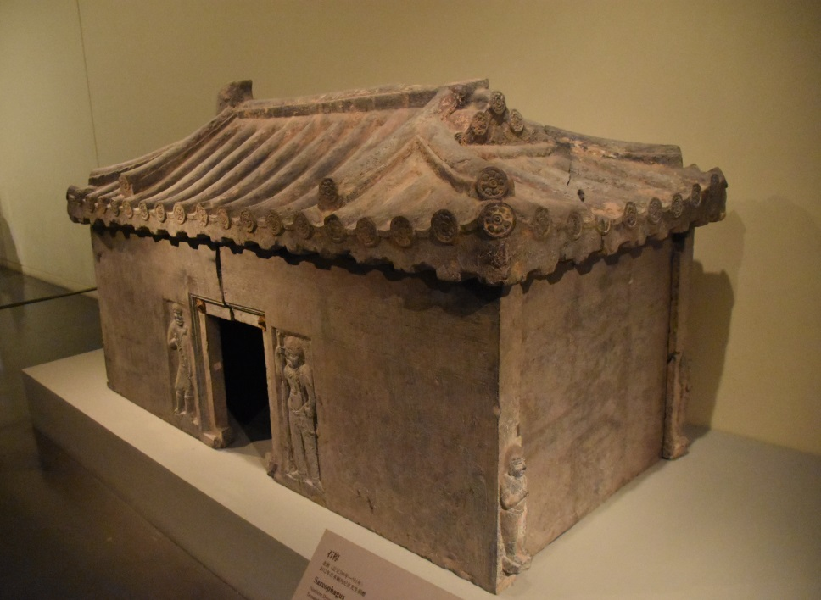
北朝石棺（北京中國國家博物館藏）
這是一個石棺材。石棺像一座大宅，除了門口，每個角落都有衛士把守。
這些衛士，都身穿翻領長袍、腳穿長靴、手持不同兵器。容貌方面則是高鼻深目、卷髮、濃鬚的胡人形象。估計石棺主人是胡人，可能就是那些定居洛陽，不能歸葬平城的鮮卑人。
請你把這兩位門衛的頭像描畫下來。

Slide 47
Stone Coffin from the Northern Dynasties (Collection of National Museum of China, Beijing)
This is a stone coffin. It is like a big house. Apart from the door, every corner is protected by guards.
These guards are all wearing lapels, long boots, and holding different weapons. In terms of appearance, the statues have the high nose, deep eyes, curly hair and thick beard of the Hu people. We may therefore guess that the owner of this coffin was a Hu person. It may perhaps even belong to the Xianbei people living in Luoyang who did not return to Pingcheng in the north.
Please draw the heads of these two guards.

Slide 48
漢
石棺的外貌（屋頂）是漢式，雕像則屬胡人，反映這個事情的文化交流與融合。
胡

Slide 49
Han
The roof of the stone coffin is in Han style but the statue shows a Hu person. This reflects the cultural exchange and integration between these two cultures.
Hu

Slide 50
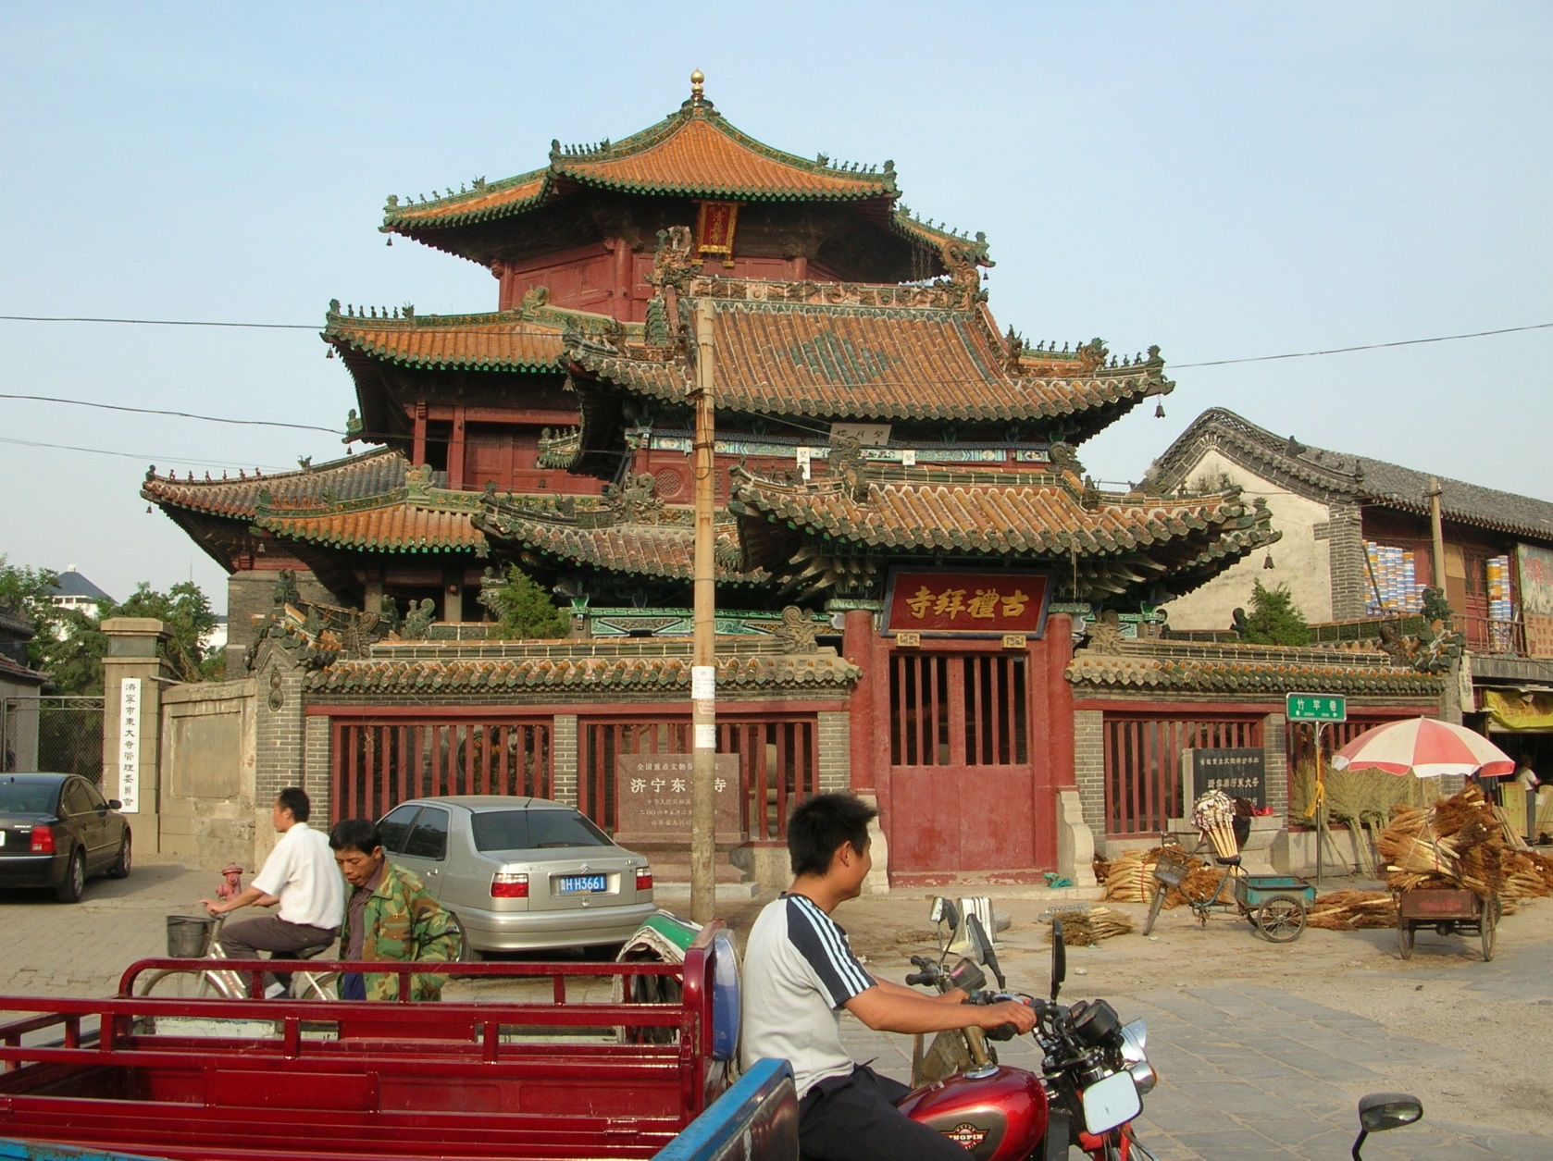
文化融和的例子
在香港是否有類似表現出文化融和的建築物？請拍照，貼在以下方格。
這是在山東的一所具有幾百年歷史的清真寺，但建築風格完全是中國式。
聖馬利亞堂
濟寧東大寺，2007年攝

Slide 51
Examples of Cultural Assimilation
Are there similar buildings that show cultural harmony among the minorities in Hong Kong? Please take a photo and paste it in the box below.
This is a mosque with a history of several hundred years in Shandong province. But, the architectural style of the mosque is completely Chinese.
HKSKH St. Mary’s Church
A mosque in Ji’ning, Shandong

Slide 52
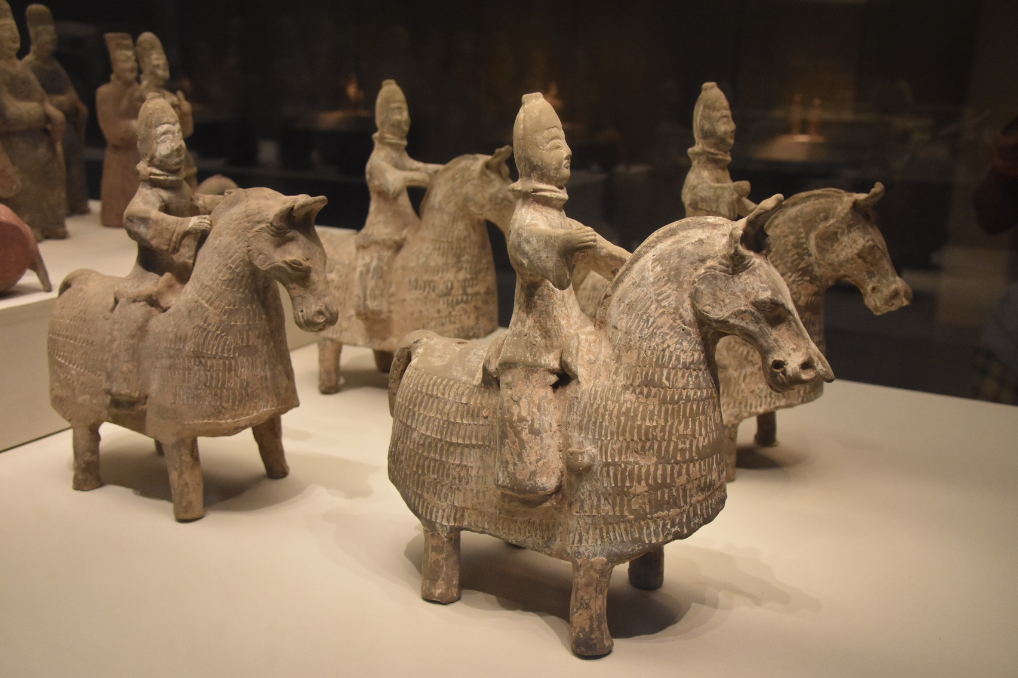
四、北魏孝文帝漢化措施
按道理，這些戰士，也可成為文官，在朝廷上討論政事。只是他們這套服裝，與其他漢人大臣的寬袍大袖服裝相比，便有點不大斯文。解決的辦法，還是要他們把上朝的服裝改成漢人式樣吧？
5. 禁胡服
鮮卑人是馬上民族，服裝是適應北方草原生活的--束褲、窄袖，方便騎馬。

Slide 53
5. Banning Hu Clothing
Technically, these warriors could also become civilian officials and discuss political affairs in the court. But, their clothes, compared with the robes and sleeves of other Han ministers, are not so elegant. The solution is to change their clothes to the Han Chinese style, right?
The Xianbei people were an ethnic group of horse riders. As such, their clothes, ankle banded pants and narrow sleeves, were adapted to life and horse riding in the northern grasslands.

Slide 54
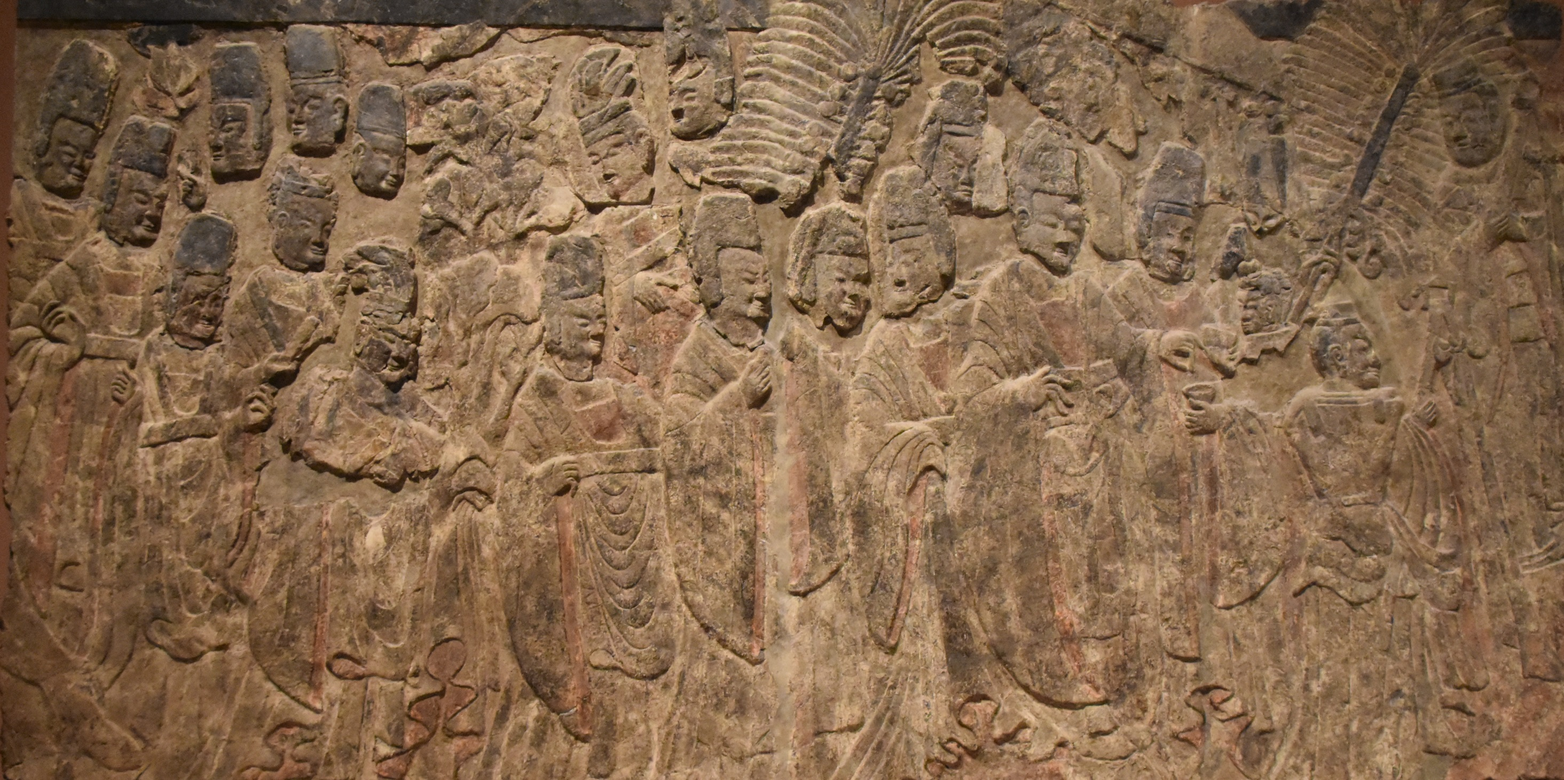
這原本是洛陽賓陽中洞內的石雕—孝文帝禮佛圖，現時收藏在紐約的大都會博物館。
石雕描繪了孝文帝率領羣臣前來禮佛，這就是漢化後的官員服裝式樣（留意高高的官帽和寬闊的長袖）。
單從服飾，已經分不出誰是漢大臣，誰是鮮卑大臣，這正是孝文帝的目的。
孝文帝
紐約大都會博物館藏

Slide 55
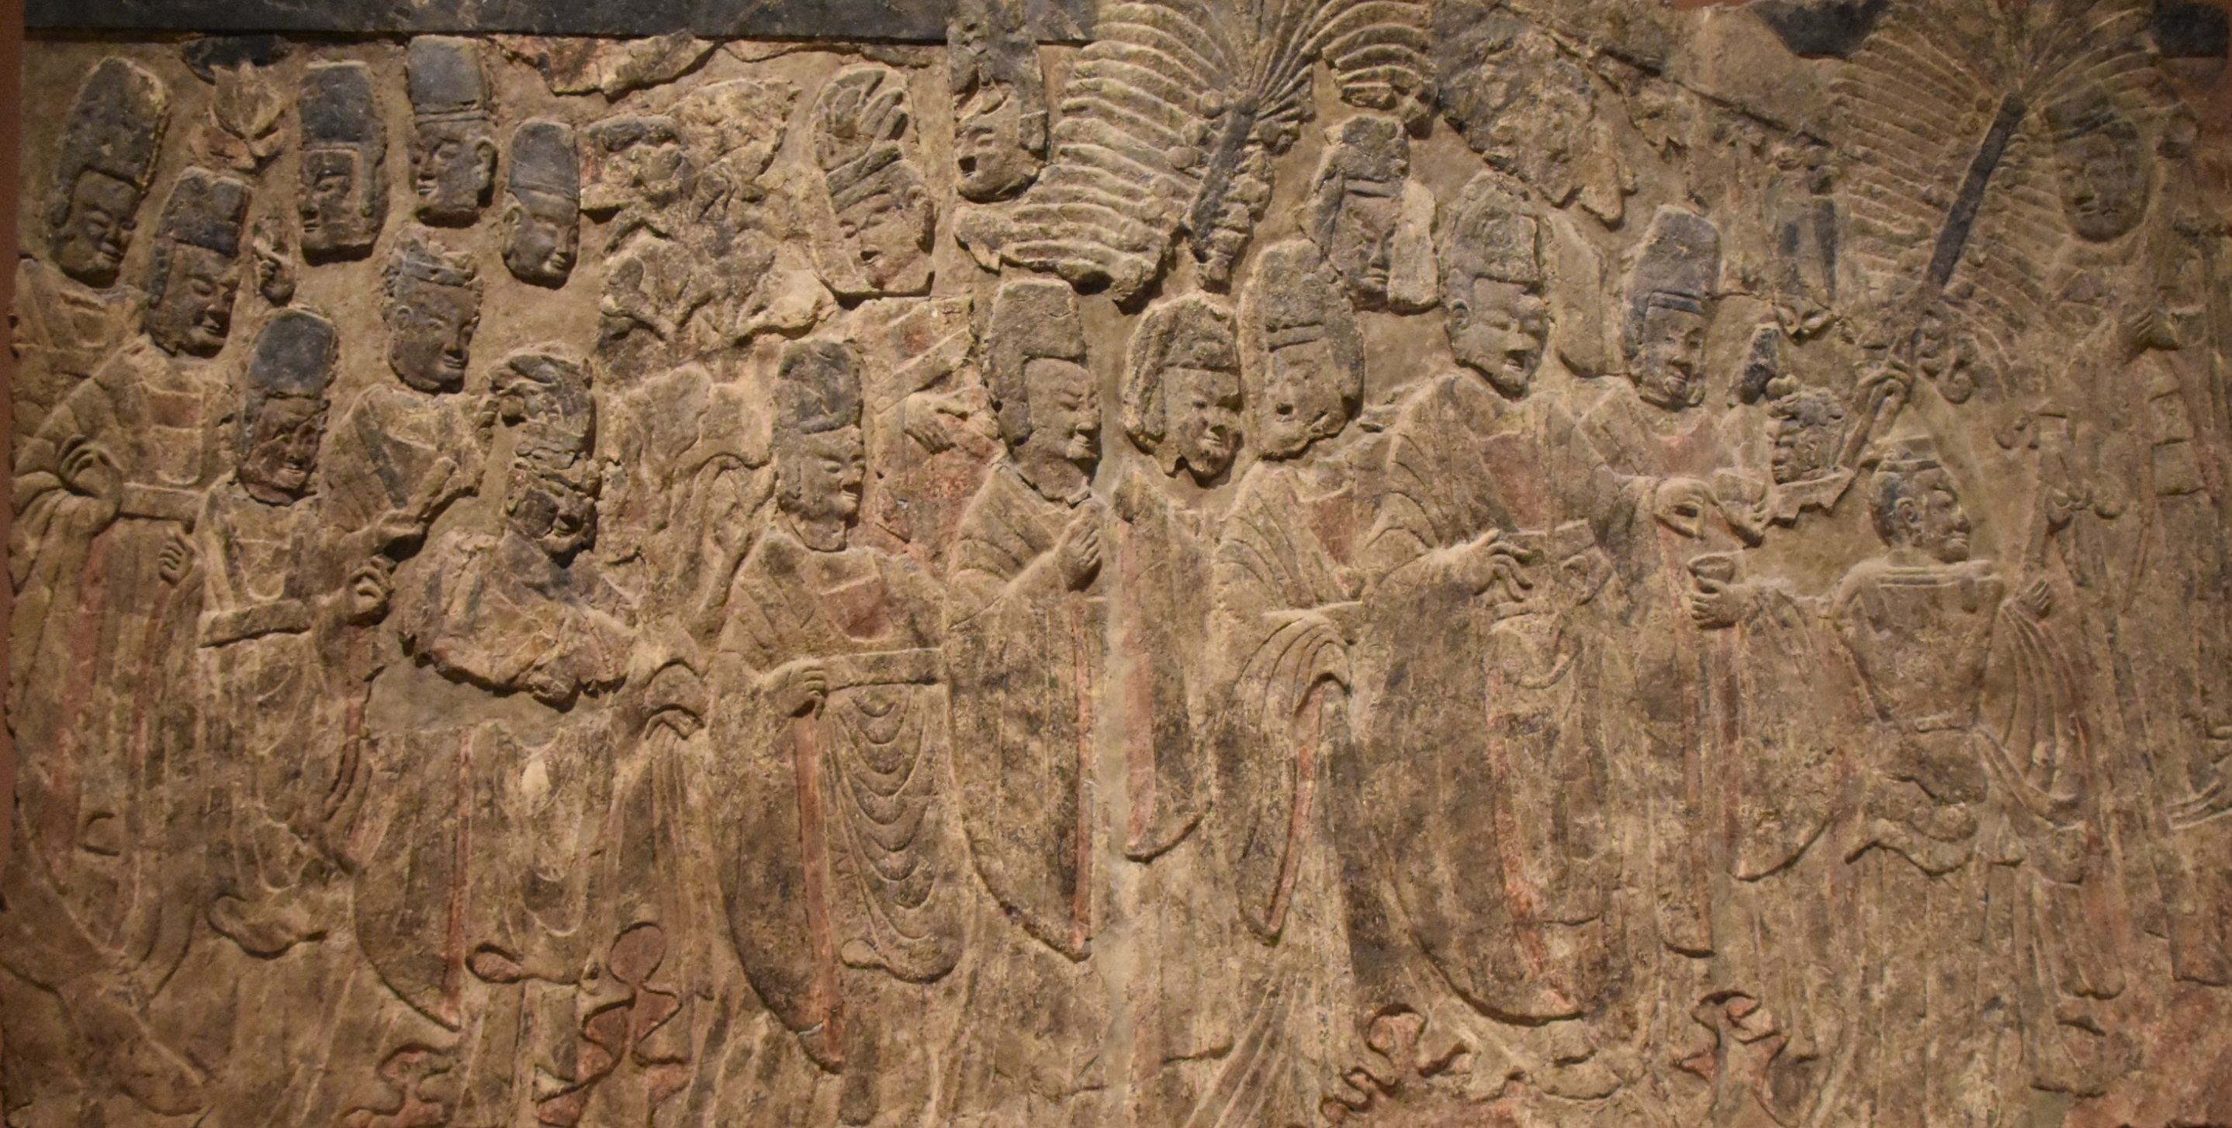
This was originally a stone sculpture in the middle cave of Binyang, Luoyang. It shows an image of a ceremony for the Emperor Xiaowen and Buddha. It is now in the Metropolitan Museum of New York.
The stone sculpture depicts Emperor Xiaowen leading a group of officials to come to worship the Buddha. This is the style of official clothing after Sinicization (note the tall official hat and long wide sleeves).
From the clothing alone, it is no longer possible to tell who is the official of Han and who is the official of Xianbei. This was exactly what Emperor Xiaowen had intended.
Emperor Xiaowen
Metropolitan Museum of New York

Slide 56
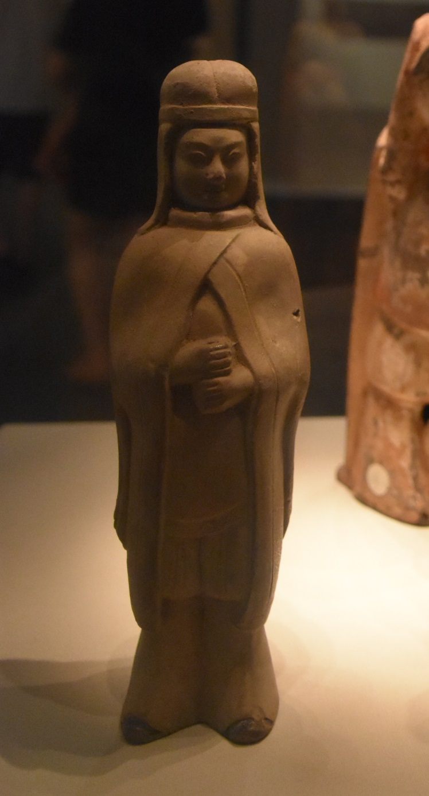
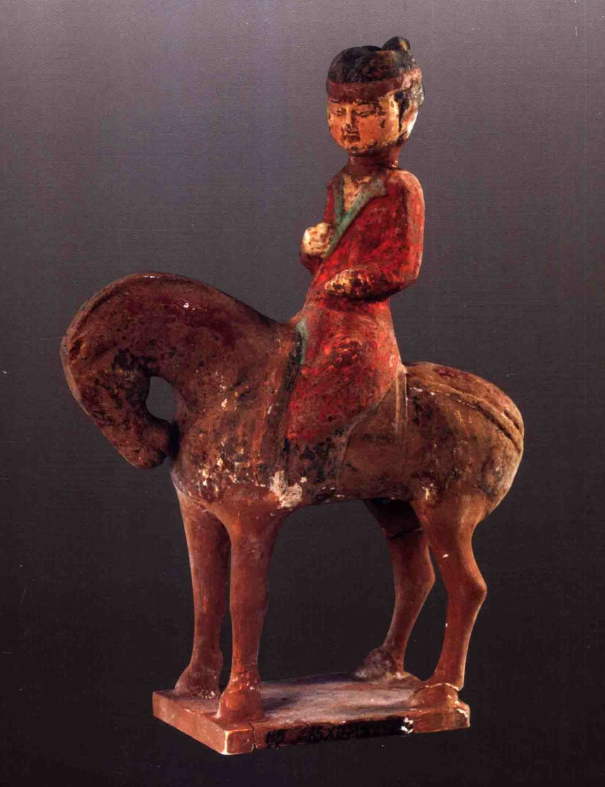
孝文帝推廣漢服，影響之下，鮮卑婦女的服飾也開始改變。這是原來的鮮卑服。
遇上寒冷天氣，便戴上風帽和披上風衣。
風帽
胡服是適應北方草原生活的服裝，束褲、窄袖，方便騎馬。
風衣
北魏陶俑（1948年河北景封縣出土，中國國家博物館藏）

Slide 57
Emperor Xiaowen promoted Han clothing. As a result, the clothing fashions of Xianbei women began to change. The below shows the original Xianbei clothing.
In cold weather, they wore hoods and cloaks.
Hood
Hu clothing was adapted to life in the northern grasslands-- ankle banded pants and narrow sleeves made horse riding more convenient.
Cloak
Collection of National Museum of China, Beijing.

Slide 58
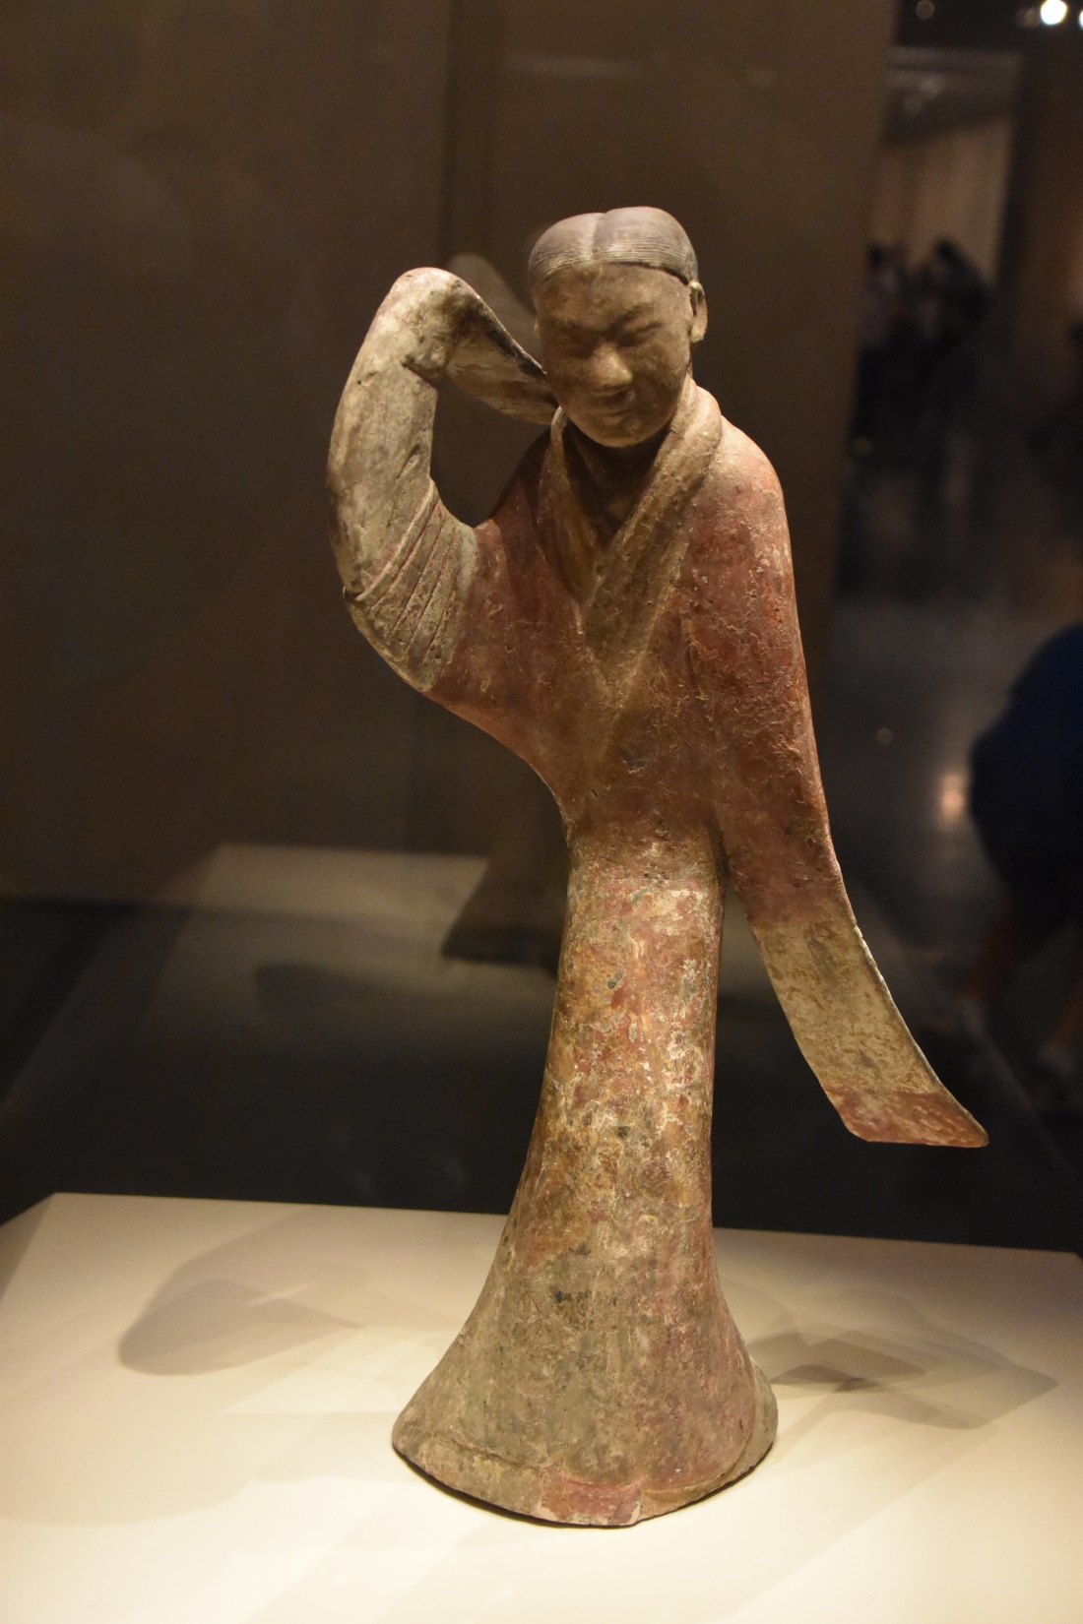
在孝文帝的推動下，北魏侍女跳舞時也是穿上了漢服。
不過她們還保留了鮮卑的風帽，以及沒有認真看待「左襟」和「右襟」的設計，於是形成了一種漢化的胡服。
漢化胡服
漢服
左
右
右
左
資料：左襟：左襟壓右襟；右襟：右襟壓左襟。
問題：漢服是左襟/右襟？（請刪一）
胡服是左襟/右襟？（請刪一）
漢服很華麗，由於是寬袍大袖，所以跳舞時特別好看。中國國家博物館藏
資料來源：劉俊喜，《大同雁北師院北魏墓羣》，北京：文物出版社，2008年。

Slide 59
With the promotion of Emperor Xiaowen, the maids of the Northern Wei Dynasty wore Han clothing when dancing.
However, they still retained the Xianbei hood and did not take the "left front" and "right front" of gown seriously. So they formed a Chinese-style Hu outfit.
Sinicized Hu Clothing
Traditional Han Clothing
Left
Right
Right
Left
Information:
Left fronted: Left front covered right front;
Right fronted: Right front covered left front.
Question: The Han clothing is left-fronted /right-fronted? (Please delete one)
Hu clothing is left-fronted /right-fronted? (Please delete one)
Performances while wearing Han clothing, with large sleeves and robes, are especially beautiful when dancing. (Collection of the National Museum of China, Beijing)

Slide 60
香港非華裔民族
請在上框中，繪畫居住香港的非華裔人士的民族服裝
或貼上你穿上民族服飾的照片。

Slide 61
The non-Chinese ethnic groups of Hong Kong
In the above box, please draw the traditional clothing of non-Chinese people living in Hong Kong or paste a photo of yourself in traditional clothing.

Slide 62
以下是宣傳“民族共融”的海報，請同學也設計一張。

Slide 63
Please design an advertisement like that of the below for "Ethnic Harmony".

Slide 64
本課題提供另外一個利用 sutori 製作的網上互動版，可供學生在家自習 / 溫習之用：
Another online interactive version of this topic produced by sutori is offered to students’ for their self-learning or revision:
胡人內徙與北魏孝文帝漢化：
Sinicization Measures by Emperor Xiaowen in the Northern Wei Dynasty:
https://www.sutori.com/en/story/hu-ren-nei-xi-yu-bei-wei-xiao-wen-di-han-hua-sinicization-measures-by-emperor--52LbMmthjnj1xHqXGJcMf61Q
二維碼：
QR code ：
發佈日期：
Date of issue:
18/1/2022

